Slide 1





SearchSYS: Towards Reliable gem5 with Search Based Software Testing and Large Language Models
A. Dakhama, K. Even-Mendoza, W. B. Langdon, H. D. Menendez, J. Petke
August 2024
gem5 Developer Meeting

Slide 2


Challenges in automated testing of gem5
Large system
Simulating hardware
The oracle problem has gotten much worse
1.34 million LOC
The input is binary of hardware that might not exist
test1.so
test2.so
gem5
test3.so
test4.so
test5.so
test6.so
test9999.so
Notes:
How do I create these binary tests?

Slide 3
Challenges in automated testing of gem5
Generative approach – hard to generate valid binaries out of thin air
Mutations – hard to mutate a binary + keep binary valid
Why do we care about valid binaries?
test1.so
test2.so
gem5
test3.so
test4.so
Not tested
test5.so
test6.so
test9999.so

Slide 4
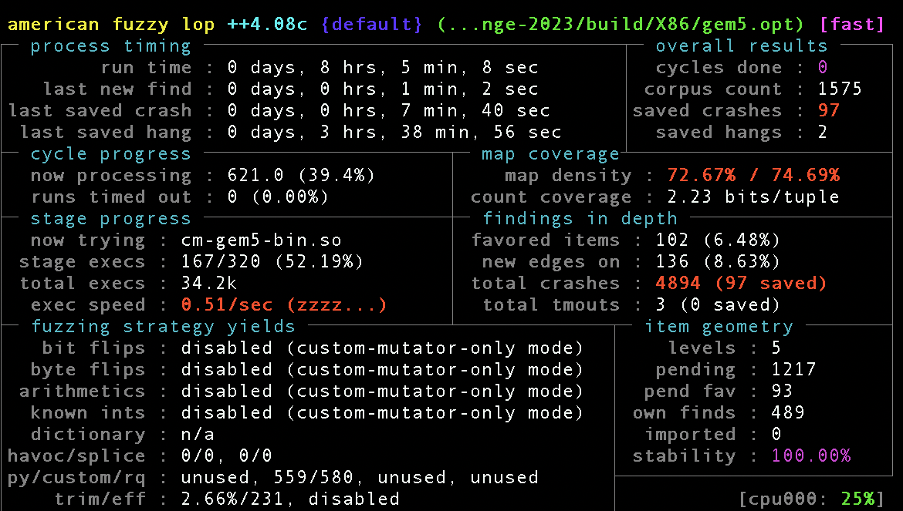


SearchSYS: LLM + AFL++
Combines LLM and AFL++
LLM – to generate a population of .so
AFL++: fuzzing + genetic algorithms (GA) to increase code coverage of gem5
test1.so
test2.so
gem5
test3.so
test4.so
test5.so
test6.so
test9999.so
Notes:
Slide 4: Testing Approach Overview
Introducing the novel testing approach for gem5
Combination of industry-standard C compiler test suites and tutorial programs
Utilization of ChatGPT (GPT 3.5) for automatic generation of parameterized C programs
Traditional – takes tones of resources vs. new approached with LLM
As pre-processing, inside/outside while testing and post-processing options
Fuzzing + SBT
Present high level
LLM in pre-processing of fuzzing/testing
Testing when fuzzing binaries, not textual data!

Slide 5

SearchSYS: LLM + AFL++
LLM generates *.so
Mutation-based
Input corpus
Fuzzing + GA engine
Custom mutator
*.so
Instrumented version of gem5
AFL++
Fuzzed corpus
…
*.so
Notes:
Slide 4: Testing Approach Overview
Introducing the novel testing approach for gem5
Combination of industry-standard C compiler test suites and tutorial programs
Utilization of ChatGPT (GPT 3.5) for automatic generation of parameterized C programs
Traditional – takes tones of resources vs. new approached with LLM
As pre-processing, inside/outside while testing and post-processing options
Fuzzing + SBT
Present high level
LLM in pre-processing of fuzzing/testing
Testing when fuzzing binaries, not textual data!

Slide 6
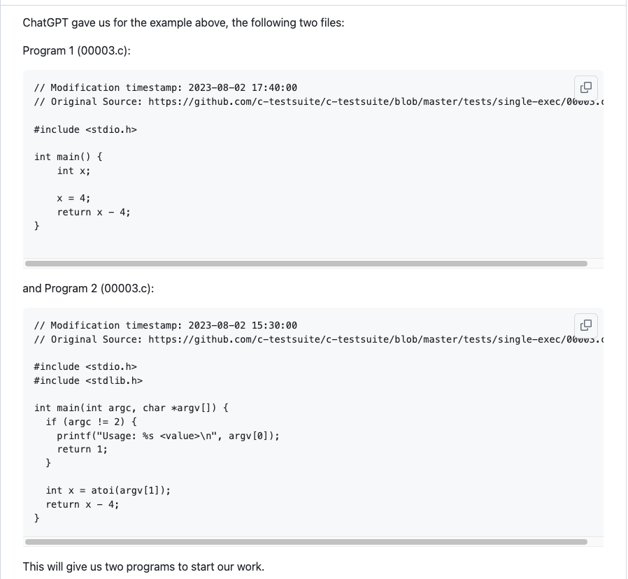
Valid binaries generation
Random + valid: using LLM
Compile Program 2 with target flag set to the right HW
GCC
Template of C program
*.so
6
Notes:
Slide 6: Corpus of Test Inputs
Overview of the corpus of test inputs constructed by compiling the parameterized C programs
Each test input includes a binary and relevant information
Slide 5: Parameterization with ChatGPT
Explanation of ChatGPT's role in creating parameterized C programs
Details on how valid values of arguments and their data types are determined
Test Input We use LLM to generate a set of C programs suitable for
testing gem5. We use a BASH script to amend minor errors

Slide 7
Diversify the inputs using mutations
Single file mutators
LLM gives us additional information regarding our test case
Input: mutate numbers or strings but keep the format
Binary level: bit flip
00003-v1.so
gem5
00003.so
5:int
9:int
Notes:
Slide 7: Extending AFL++ Fuzzer
Introduction to AFL++ as a coverage-based fuzzer
Explanation of the extensions made to AFL++ for generating new test inputs
Slide 8: Test Input Generation
Insights into the process of generating new test inputs using the extended AFL++
Emphasizing the role of coverage-based fuzzing in exploring the test input space
Coverage-Guided Mutation-Based Fuzz Testing using AFL++ [9,18]

Slide 8
Further testing: post fuzzing
Crashes+hangs: during fuzzing with AFL++
Logical bugs?
Once we have the target: test for mis-simulations
Mis-simulation: execution with gem5 *.so on target
Fuzzed corpus
00003-v1.so
gem5 simulation
Cross-check results:
Mis-match might indicate a bug in gem5
9:int
*.so
Execute test in HW
Notes:
Differential Testing Per test case, we compare the result from gem5 to
the actual test execution.

Slide 9
Evaluation
Corpus of Binaries:
  C programs - created using various LLMs
  Binaries – compiled with GCC-11 –O3 x86_64
  Input, types – generated with LLMs too
Requires heavy instrumentation of gem5:
(e.g.) 72 GB RAM, 16 cores
Fuzzing campaign:
Over 700 days with various input corpora
  We still analysing the results
00003.so
5:int
Notes:
Slide 9: Testing gem5 with SearchGEM5
Running the generated 4005 binaries through gem5
Significantly increasing test coverage by more than 1000 lines

Slide 10
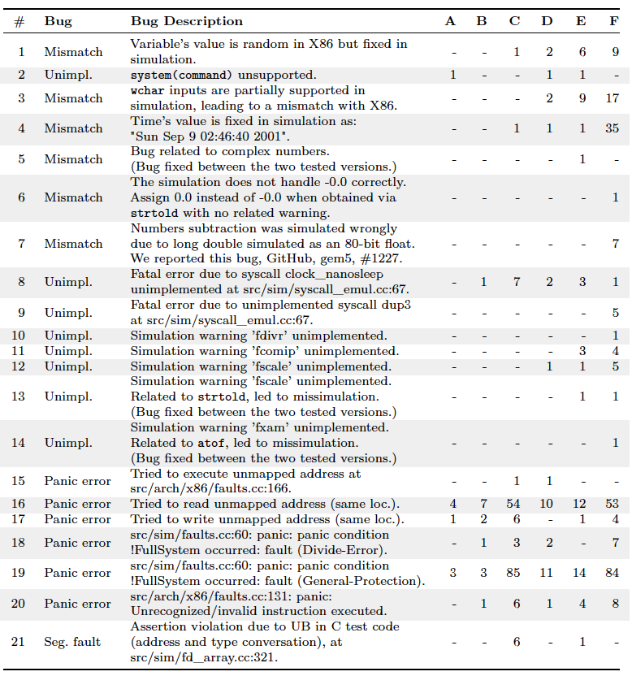

Bugs: LLM-generated test inputs
Used each LLM to
generate data for 25 hours
Six models:
 | LLM
A | TinyLlama
B | Phi2
C | Llama2
D | Magicoder
E | CodeBooga
F | GPT-3.5-turbo
Notes:
A day per model (25 hours)

Slide 11
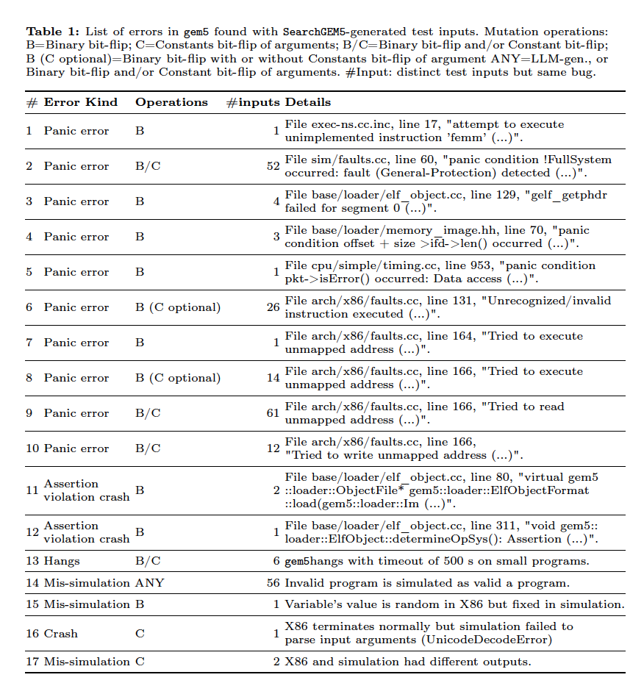
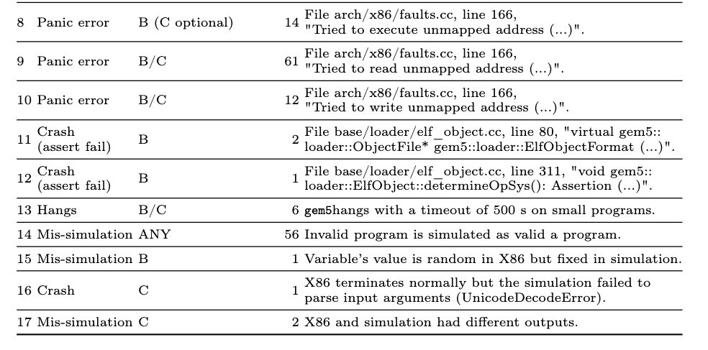
Bugs: do we really need mutations?
10 days of fuzzing data
Input corpus: 744
Fuzzed: 2136 unique
gpt-3.5 set (August 2023)

Slide 12
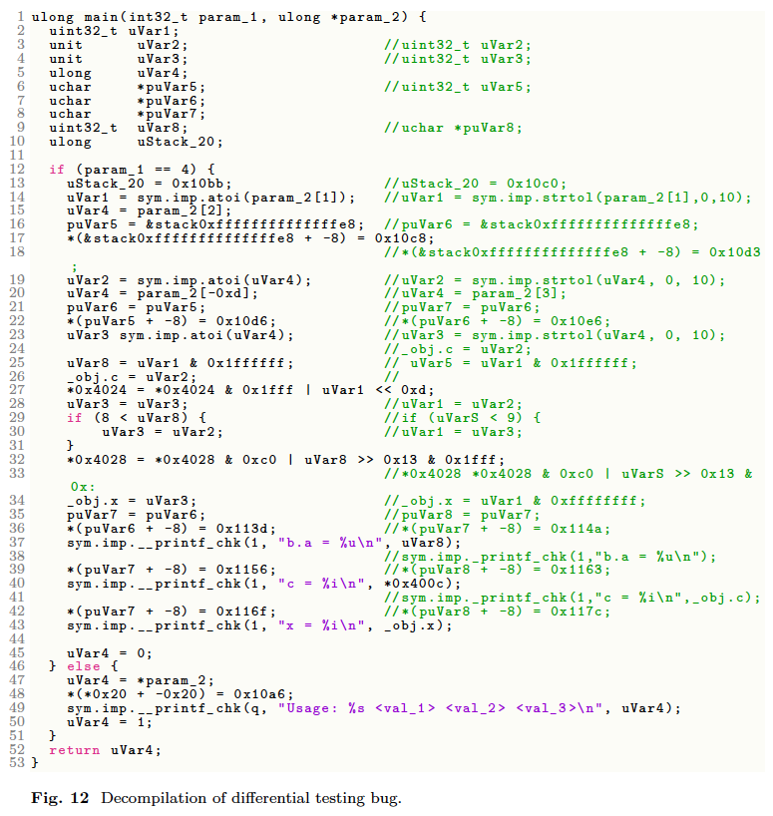
Bugs: Are our mutations sensible? What binaries do we get?
Missimulation example:
Input: 0 0 0
Native prints: b.a = 0, c = 22091, x = 0
Simulation prints: b.a = 0, c = 0, x = 0
The original is in the comments only when there are differences

