Slide 1


Beginner’s Python – Session Three
The AZ Code Club Team
Blank Template
Filled Template

Slide 2
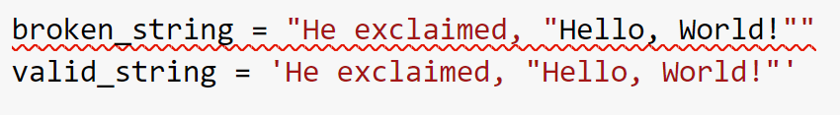

Variable Types Recap
When introducing string variables, we learned that we define them using double quotes
It turns out that single quotes are equally valid
We typically use double quotes for text that makes up a full sentence and single quotes for individual terms and technical names
We can use double quotes inside of a single-quoted string and vice-versa but not double in double

Slide 3
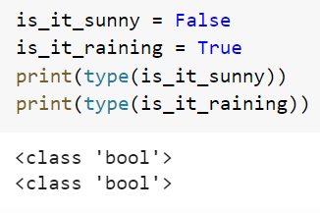
Variable Types Recap
So far we have looked at four variable types: integers, floats, strings, and lists
Another useful type is Booleans, named after George Boole
A Boolean variable can have one of two values, True or False (not the capitalisation)

Slide 4

Session Content
Comparisons
Control Flow
Boolean Operators
While loops

Slide 5
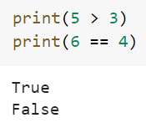
Comparison Operators
We can construct Boolean variables by using comparison operators
These are most commonly used to compare two numbers
The most built-in comparison operators are shown in this table
We place these between two numbers to use them
Operator | Meaning
== | Equal to
!= | Not Equal to
> | Greater than
< | Less than
>= | Greater than or equal to
<= | Less than or equal to

Slide 6
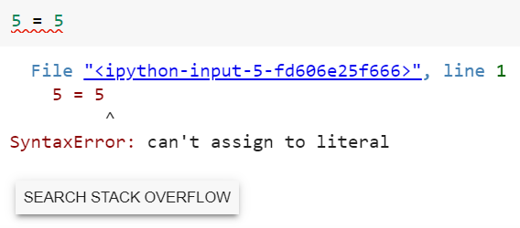
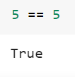
Comparison Operators
Make sure you noticed that to check for equality, we don’t use = but rather ==, a double equals
This is because we are already using = for variable assignment
This is a common mistake and so if Python gives you an error when dealing with comparisons, this should be the first thing to check

Slide 7
Comparison Operators Puzzles
Use Python’s comparisons to answer the following questions:
  Is the 7 greater than 3?
  Are 3 and 4 the same number?
  Is 9 at least as big as 9?
Ask the user the input a number (don’t forget to convert to an integer) and print True if it is positive
Create a list and check if the smallest element is equal to two
Bonus: Try using the comparison operators to compare two strings. What rule determines which is greater than the other? (Hint: think back to using min() and max() with strings)

Slide 8
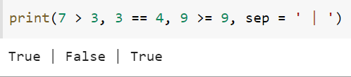
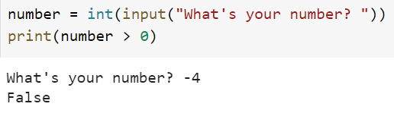
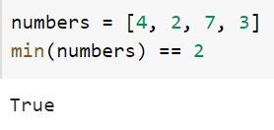
Comparison Operators Puzzles Solutions

Slide 9
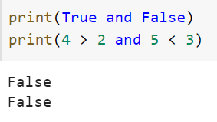
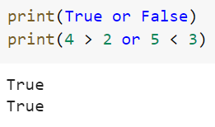
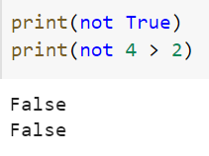
Boolean Operators
Just like integers/floats have their own set of operators (+, -, *, /, etc.), so do Booleans
The main three we will need to care about are `and`, `or`, and `not`
We use `and` and `or` just like the arithmetic operators, placing them between two Booleans (either Boolean variables or comparisons)
`not` is slightly different since it only acts on one Boolean variable
We use it by placing it before a Boolean to negate it

Slide 10
Boolean Operators
`not` simply turns True to False and vice versa
It is easiest to see what `and` and `or` using what’s called a truth table
Confusingly, unlike in everyday speech, x or y will be True when both x and y are True
There is a clever reason for this but for now it’s best to just accept and remember it
x | y | x and y | x or y
True | True | True | True
True | False | False | True
False | True | False | True
False | False | False | False

Slide 11





Boolean Operators Exercises
What do you think the following Boolean expressions will evaluate to? Make your guess then try them for yourself
Create two Boolean expressions, one True and one False
Bonus: We can use brackets to compare multiple Boolean operators together. Remember start with the inner-most brackets first. Guess the value and then evaluate to check the following expressions

Slide 12
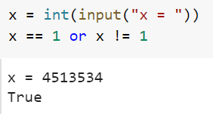
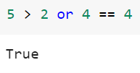
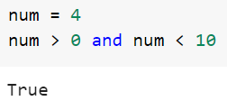
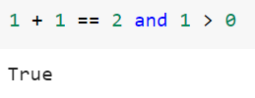
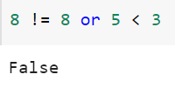
Boolean Operators Solutions
There are obviously infinitely many solutions to this but here are two:

Slide 13
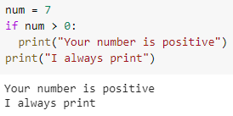
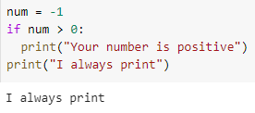
Control Flow—If Statements
We can add logic to our code using `if` statements
These accept a Boolean value (likely a comparison or Boolean expression) and run code only if it is `True`
We write an `if` statement by using the `if` keyword, followed by our condition and a semi-colon
We then indent any lines of code that should only be ran if the condition is True. We unindent to end the `if` statement

Slide 14
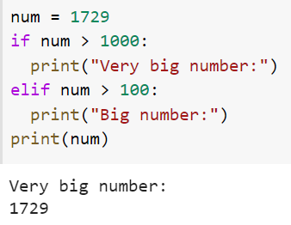
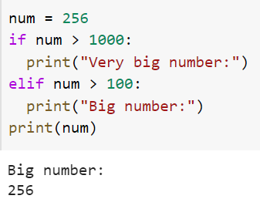
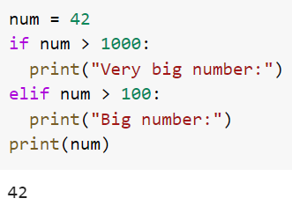
Control Flow—Elif Statements
Perhaps we have more than one case we wish to check
In this case we can follow the `if` statement with an `elif` statement
The syntax is the same (`elif`, condition, colon, indented block)
The `elif` statement will only run if the condition in the `if` statement was false

Slide 15
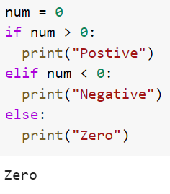
Control Flow—Else Statements
The last block we can include is an `else` statement
This will run only if every other `if` and `elif` statement was false
For this reasons, we don’t specify a condition
Think of this a default or backup case
Summary:
Statement type | How many are allowed? | Include a condition?
if | Exactly one | Yes
elif | Any (or none) | Yes
else | One or none | No

Slide 16

Control Flow Puzzles
Ask for the user’s age. If they are younger than 13 print “Child”, otherwise if they are younger than 20 print “Teen”, otherwise, if they are at least 60 print “Possibly retired”. Failing all these, print “Adult”
Create a random number between 1 and 10 using the following code:
Ask the user to guess the number and print whether they were too low, too high, or bang on
Bonus: Ask the user for a decimal number and round it using the round() function. Print whether the number was rounded up, down, or not at all using control flow

Slide 17
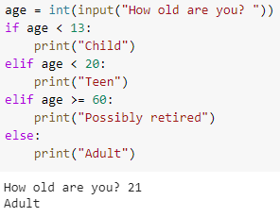
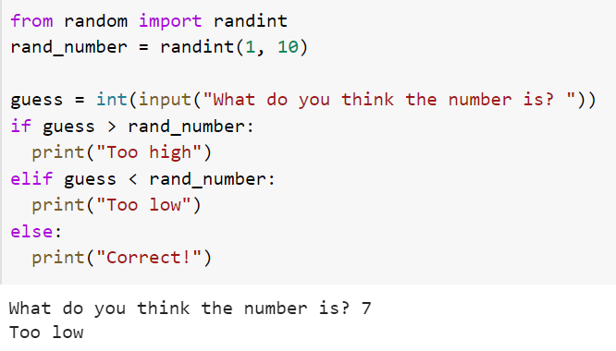
Control Flow Puzzles Solutions

Slide 18
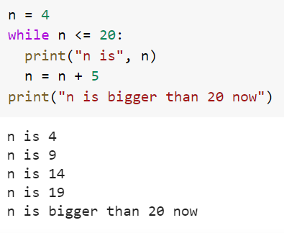
While Loops
Often, we’ll want to repeatedly run code until a condition is met
We can use while loops to achieve this
The syntax is similar to `if`, `elif`, and `else`
Start with a `while`, then a condition and colon
Follow this by indented lines that will be looped whilst the condition is true
Any lines after the indent will be ran after the loop exits

Slide 19
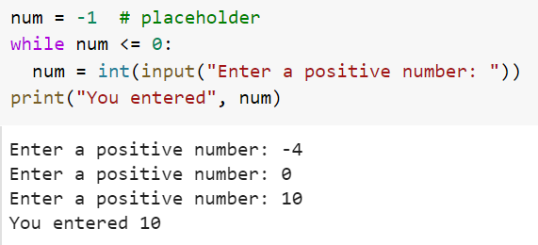
While Loops
We can use while loops to validate user input
Note, if you have a condition in your while loop that never becomes false, you will get stuck in an infinite loop. To escape this, press the stop button next to the code cell

Slide 20
While Loops Puzzles
Use a while loop to count down from 10 to 1 then say “Blast off!” (Hint: create a variable with initial value 10 and decrease it by one at the end of each iteration)
Bonus: Have the user decide the original number to count down from
Bonus: Search the web for ‘Python assignment operators’ and use these to make your code a bit cleaner
Super Bonus: Use an `if` statement within the while loop to only print out even numbers (Hint: you can get the remainder of x divided by y using `x % y`. This will be zero if and only if y divides x)

Slide 21
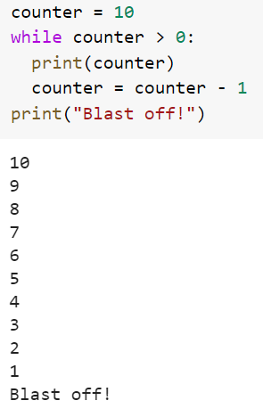
While Loops Puzzles Solutions

