Slide 1


Beginner’s Python – Session Seven
The AZ Code Club Team
Blank Template
Filled Template

Slide 2


Session Content
Limitations of lists/tuples
Introduction to dictionaries
Manipulating dictionaries
Looping through dictionaries

Slide 3
Limitations of Lists/Tuples
Lists and tuples are flexible data types but they also have limitations
They are a great way to store data that has a well-defined order and so can be indexed by non-negative integers
What can we do when the data we have to store doesn’t have such a nice structure? — We use a dictionary!
Index | Value
0 | Beijing
1 | New Delhi
2 | Tokyo
3 | Moscow
Key | Value
England | London
France | Paris
Germany | Berlin
Spain | Madrid
Paradigm of list/tuple
Paradigm of dictionary

Slide 4
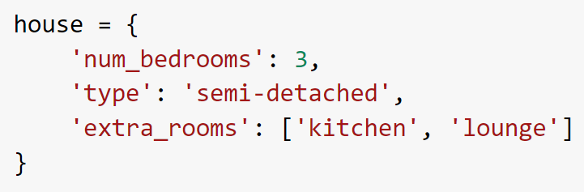
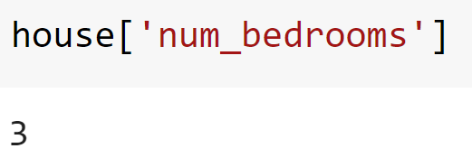
Dictionaries
We create dictionaries in Python using curly brackets
We then separate multiple items by commas
Each item is formed of a key-value pair separated by a colon
Keys are typically strings, integers, or floats and can be thought of as the ‘address’ of the value
We access dictionaries’ values in the same way as a list

Slide 5
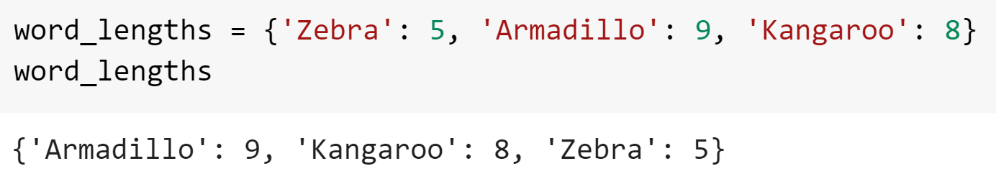
Tangent: Ordered Dictionaries
Python does not keep track of the order of keys in a standard dictionary
For that reason, even if you write items in a specific order when defining a dictionary, you should pretend that they are shuffled up straight after
If you need to keep track of the order then Python offers an ordered dictionary, but this is rarely needed in practice

Slide 6
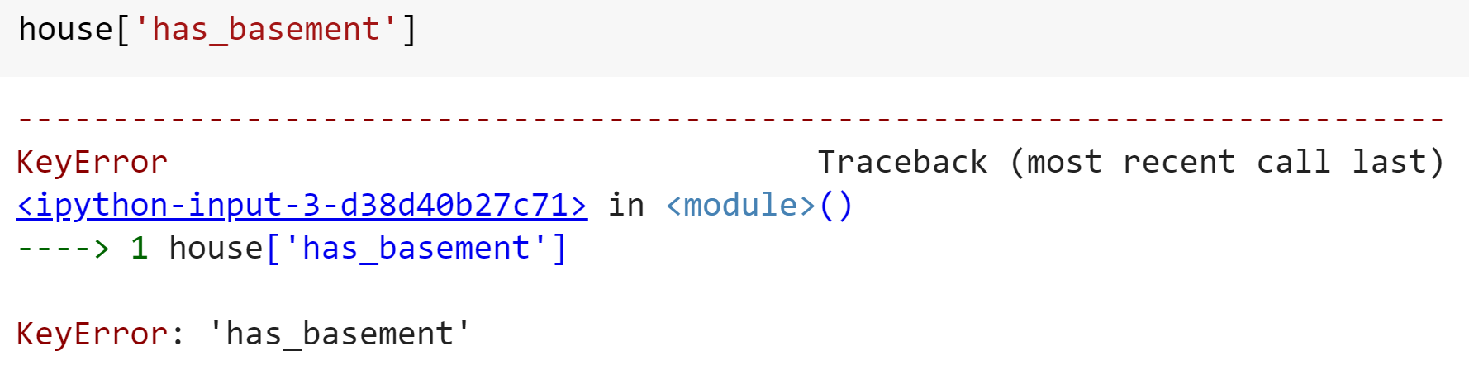
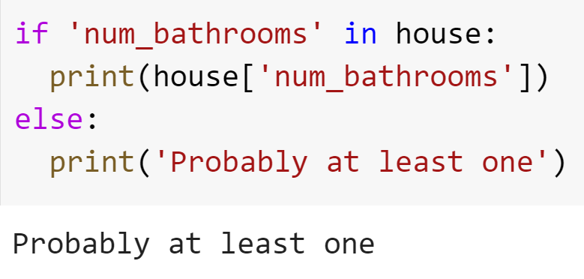
Dictionaries
What happens when we try to access a key that doesn’t exist in a dictionary?
We can check for a key using the in keyword

Slide 7
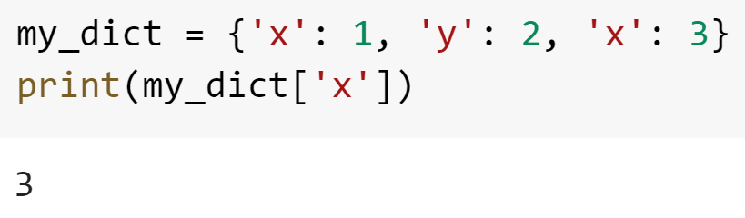
Dictionaries Puzzles
Create a dictionary with some information about you. Try to include at least one value of each of the types integer, string, list and Boolean.
Print out some of the values of the dictionary
What do you think the following code will do? Try it.
Bonus: You can also access dictionary values using the .get() method. What is the advantage of using this over standard indexing? (Hint: search for ‘python dictionaries get’)

Slide 8
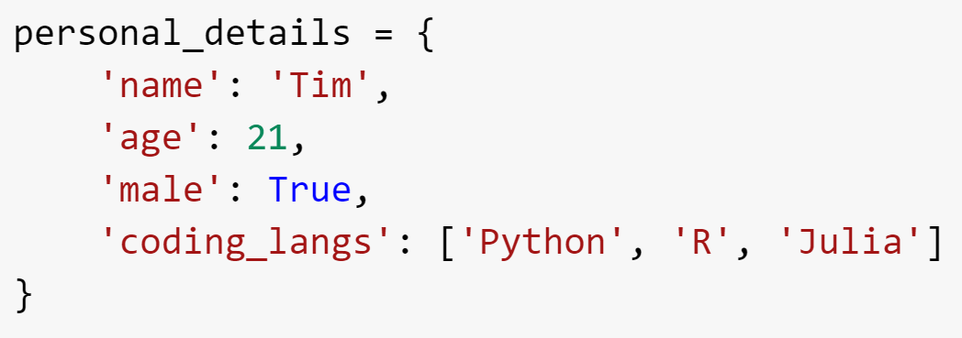
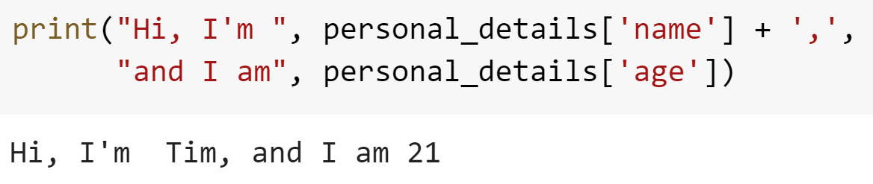
Dictionaries Puzzles Solutions

Slide 9

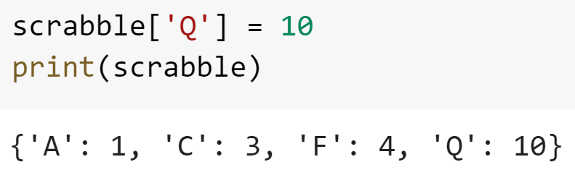
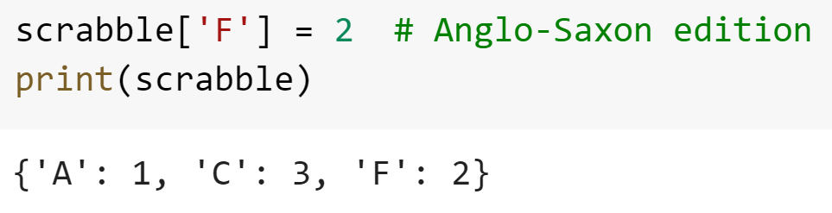
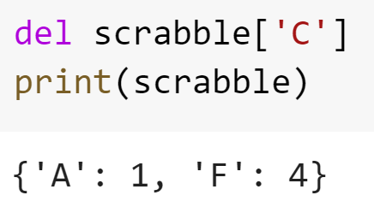
Manipulating Dictionaries
Just as with lists we can…
Add a new item
Delete an item by key
Overwrite a value
Deleting an item by value is a bit tougher — we will look at doing this in the homework sheet

Slide 10
Manipulating Dictionaries Puzzles
Create a dictionary containing with keys ‘one’, ‘two’, and ‘three’ which corresponding values 1, 2, and 4
Correct the value for key ‘three’ to be 3 and add a new pair ‘four’: 4
Create an empty dictionary called square
Loop through the range -5 to 5 (inclusive), each time adding an item to the dictionary which maps the looping variable to its square
Bonus: Create a dictionary called employees which contains two dictionaries, each giving the details (say, job title and manager) of a different employee. Access the manager of one of the employees

Slide 11
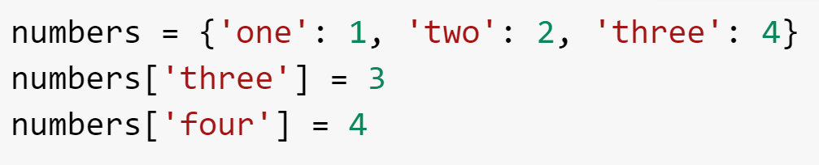
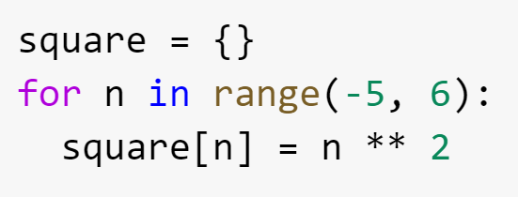
Manipulating Dictionaries Puzzles Solutions

Slide 12

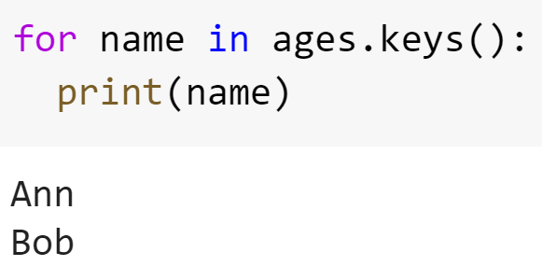
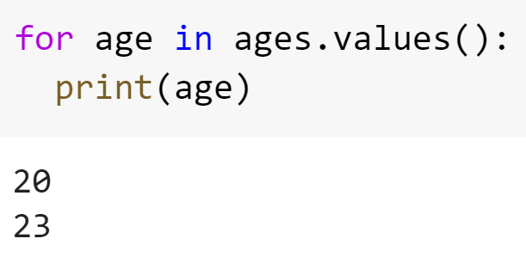
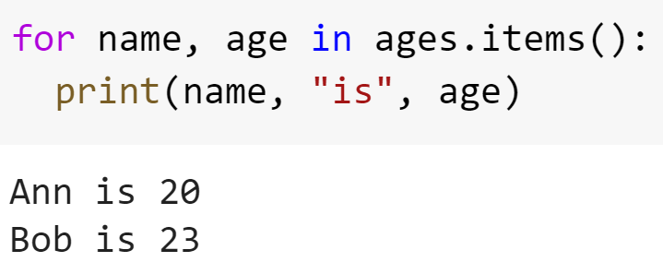
Looping Through Dictionaries
Python offers use three ways to loop through dictionaries
By Key
By Value
By Item (Both)

Slide 13
Looping Through Dictionaries Puzzles
Create a function that accepts a list of strings and counts how many times each string occurs, printing the results in the form
There are 12 occurrences of ‘spam’
Hint: Create an empty dictionary to store these counts. Loop through each string in the list. If the string is already a key for the dictionary, increment its value; otherwise, add it with value one.
Bonus: Add a special case for when there is only one occurrence of a string so that the output is grammatically correct

Slide 14
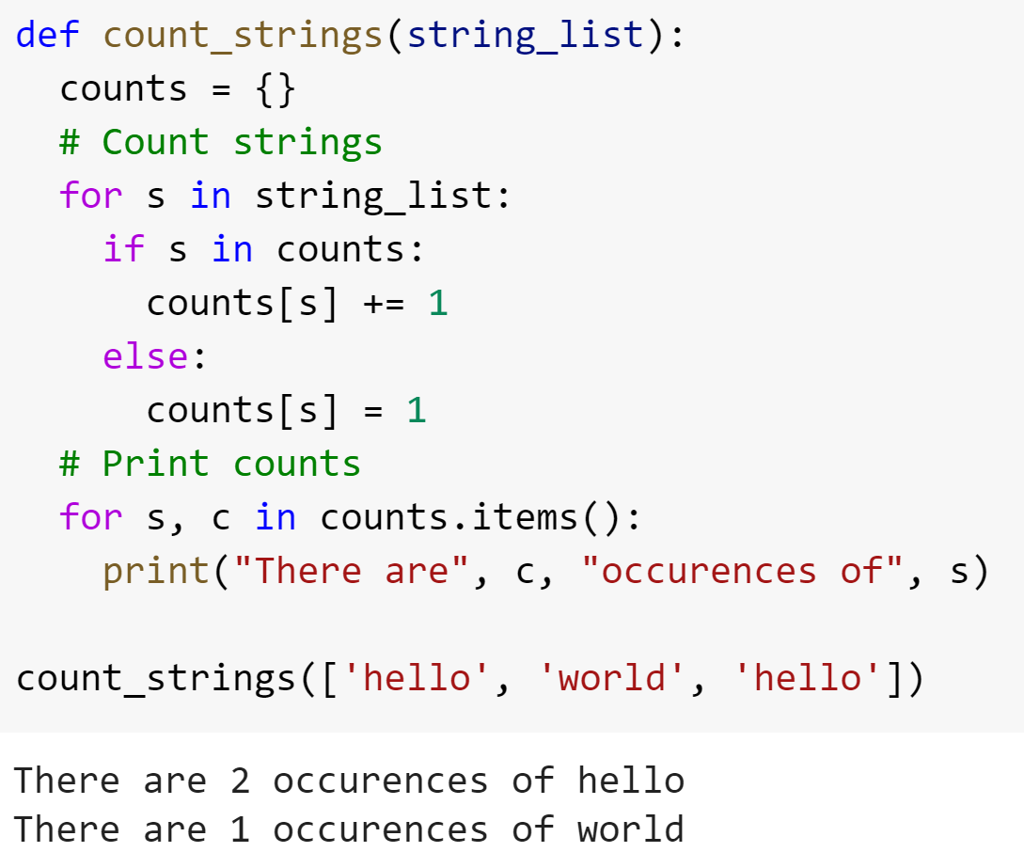
Looping Through Dictionaries Puzzles Solutions

Slide 15
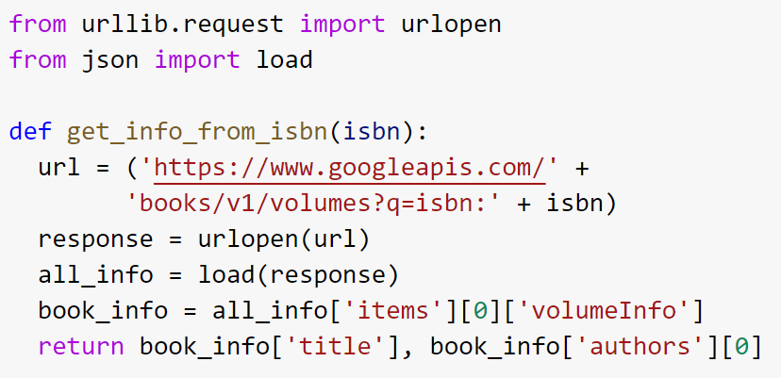
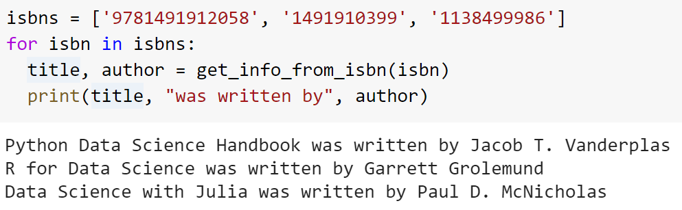
Tangent: APIs and JSON

